Slide 1
Math Modeling for the Erythropoietin Receptor

Slide 2
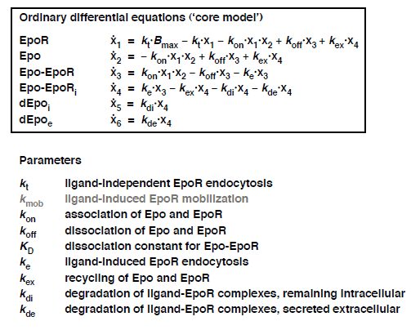
Core Model

Slide 3
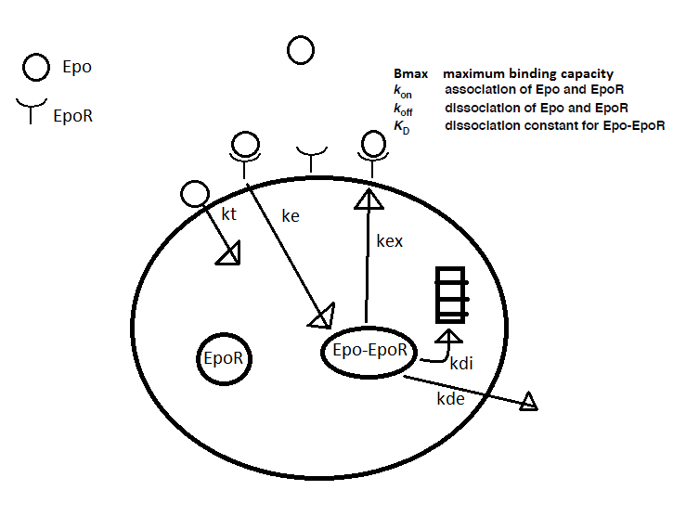
Core Model Parameters

Slide 4
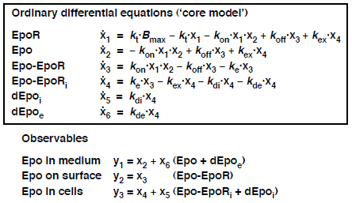
Observables

Slide 5
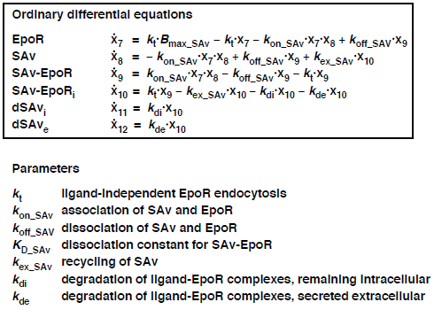
Auxiliary Model

Slide 6
Methods
Becker et al.
Toban (Me)
PottersWheel
Trust Region Optimization
Chi Squared Tol 10e-7
Fit parameter Tol 10e-7
200 iterations
Control Coefficients (Sensitivity)
Python 2.7
Emcee MCMC Hammer
36 Chains
3000 Steps
500 burn in
Sobol (Sensitivity)
N = 3000
Steps = 300
Params = 10

Slide 7
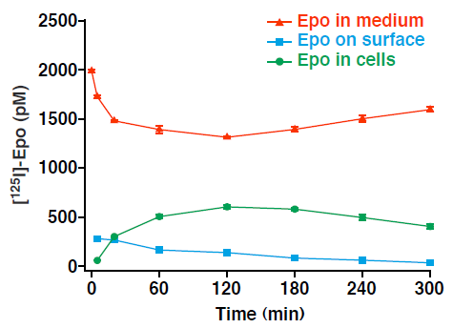
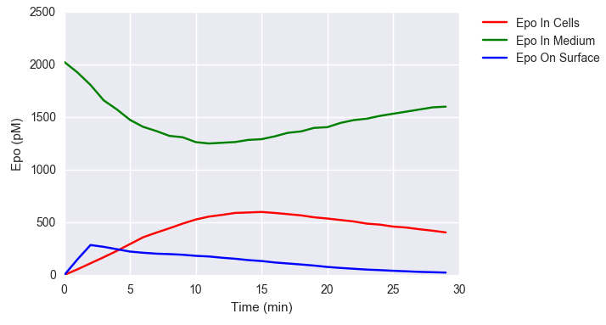
Epo Observed
Becker et al.
Toban

Slide 8
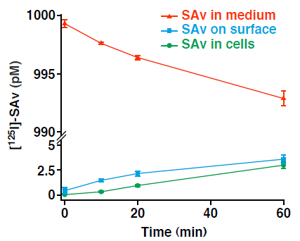
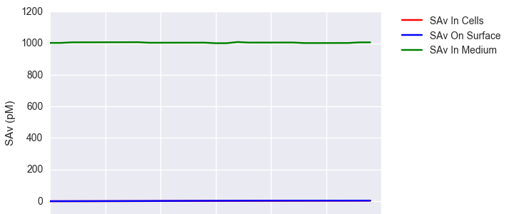
SAv Observed
Becker et al.
Toban

Slide 9
Initial Values and Parameter Ranges
Initial Values
Parameter Ranges
EpoR: Bmax
SAvR: Bmax_SAv
Epo: within 10% of 230.19 *
SAv: within 10% of 999.293 *
All others 0
m: 0 < m <= 1
10e-7 < p < 10e3

Slide 10
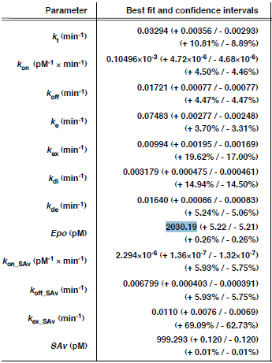
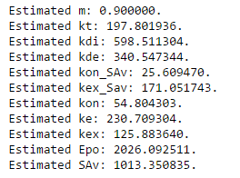
Parameter Results
Becker et al.
Toban

Slide 11
Parameter Results Consequence
Ligand Induced vs Ligand Independent
Endocytosis
Becker et al.
Toban
kt (ligand independent) = 0.033
ke (ligand induced) = 0.075
ke/kt =aprox 2
Epo binding increases endocytosis. Although there is an increase in endocytosis, it is not as big an increase as current theory suggest.
kt (ligand independent) = 197
ke (ligand induced) = 230
ke/kt =aprox 1
Epo binding causes practically no increase in endocytosis. This implies ligand independent endocytosis is significantly underestimated with current theory.
Conclusion
Ligand independent endocytosis is more prevalent than originally thought.

Slide 12
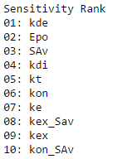
Sensitivity Results
Results
Conclusion
The amount of Epo-EpoR that is degraded plays the most important role, but the amount of Epo to start with is second. This implies that the cells do have significant reactions to the amount of Epo and the amount of Ep-EpoR the cell degrades may be the cause of that reaction.
Ligand independent endocytosis is the next most sensitive parameter. Showing it’s significance above ligand dependent endocytosis as previously concluded from the parameters.

Slide 13
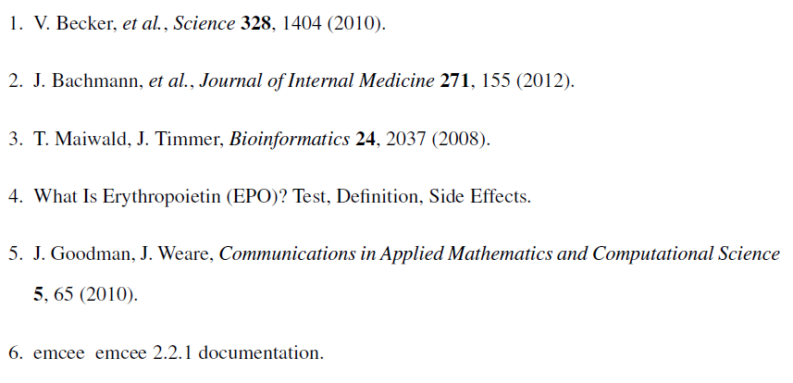
References

